Slide 1
HACKATHON · HINDSIGHT HACKATHON 2026
VendorGuard AI
AI Agent with persistent memory for vendor security risk assessment and compliance automation.
TEAM
Team Name : Hack Sparks
TRACK
INSTITUTION
Persistent Memory + AI Agents (Hindsight)
College Name : Bangalore Institute of Technology (BIT) & Sapthagiri NPS University

Slide 2
01 · THE PROBLEM
Vendor security reviews are slow, manual, and routinely skipped.
1–4
60%
0
weeks per vendor review
of breaches involve a third party
tools non-experts can actually use
WHO IS AFFECTED
CURRENT SOLUTIONS & GAPS
Procurement teams delayed by long vendor security questionnaires (100–200+ questions)
SIG / CAIQ spreadsheets
Manual, 2–6 weeks, vendor-self-reported
Founders & Product Managers who skip reviews, creating Shadow IT risks
GRC platforms (OneTrust, Vanta)
Expensive, built for security pros only
Security teams drowning in repetitive vendor audits
Google search
Compliance officers chasing missing evidence
No structured output, no audit trail
“Procurement delays cost real money — and skipped reviews cost reputations.”
2 / 7

Slide 3
02 · PROPOSED SOLUTION
Type a vendor name. Get a risk verdict in 3 seconds.
VendorGuard is an autonomous AI agent that researches, scans, scores, and audit-logs vendor security posture — built for people who have never read a SOC 2 report.
AUTONOMOUS
EXPLAINABLE
GOVERNED
Researches on its own
Plain-English verdict
Policy-gated & audit-logged
Crawls the vendor's site, trust center, privacy policy, breach databases, and public assets — no human input.
Low / Medium / High risk with rationale, evidence links, and a structured report any stakeholder can read.
High-risk approvals require human review (ArmorIQ). Every decision and tool call is logged as compliance evidence.
WHY IT'S BETTER
2 weeks → 3 seconds · Security expert required → Anyone · No audit trail → Compliance-grade evidence
3 / 7

Slide 4
03 · ARCHITECTURE & TECH STACK
Agentic pipeline with governance baked in.
INPUT
RESEARCH
SCAN
REASON
GOVERN
OUTPUT
Vendor URL
▶
Web crawl + Trust center
▶
ArmorClaw asset scan
▶
LLM risk scoring
▶
ArmorIQ policy gate
▶
Verdict + Audit log
FRONTEND
AGENT CORE
React · TanStack · Tailwind
TypeScript · AI Agent · GPT-4o
Persistent memory + reflection workflow
Single-input UI, live agent trace, verdict report
Tool-using agent with planning + reflection loop
SECURITY APIS
DATA LAYER
ArmorIQ SDK + Hindsight
Policy gating + memory recall + audit logs
Lovable Cloud (Postgres) · pgvector
Policy gating, audit log, external asset scan
Vendor cache, evidence store, audit trail
INTEGRATIONS
ArmorIQ • Hindsight • OpenAI • Supabase • Web Search
4 / 7

Slide 5
04 · KEY FEATURES
Five capabilities competitors can't match.
01
3-Second Vendor Verdict
02
Autonomous Evidence Gathering
Type a name. Get Low/Medium/High risk with rationale and evidence — instantly.
Agent finds SOC 2, ISO 27001, GDPR, HIPAA, DPA, sub-processor lists without being told where to look.
03
Live Asset Scan (ArmorClaw)
04
Policy-Gated Approvals (ArmorIQ)
Detects exposed S3 buckets, weak TLS, missing security headers on the vendor's public surface.
High-risk vendors can't be approved without a human reviewer. Guardrails enforced by the platform.
05
Compliance-Ready Audit Trail
Every tool call, every reasoning step, every decision — logged and exportable for SOC 2 / ISO audits.
INNOVATION · Dual integration of ArmorIQ + ArmorClaw inside a single agent loop — governance and reconnaissance working together.
5 / 7

Slide 6
05 · IMPACT & FEASIBILITY
Built to ship. Built to scale.
WHO BENEFITS
FEASIBILITY
Startups & SMBs
Cost per evaluation
~$0.04 (LLM + scan)
Get enterprise-grade vendor diligence without a security team
Build time to MVP
Working prototype in 48 hrs
Enterprises
Deployment
Serverless on Lovable Cloud + Workers
10x faster procurement; auditors love the evidence trail
Scalability
Stateless agent — horizontal autoscale
Procurement / Finance
Self-serve risk verdict before signing contracts
Data moat
Vendor verdict cache grows with each query
REAL-WORLD IMPACT
99.9%
reduction in time-to-decision per vendor review.
6 / 7

Slide 7
06 · DEMO & CONCLUSION
From 2 weeks to 3 seconds.
VendorGuard.app / evaluate
ONE-LINE CONCLUSION
▸ vercel.com
VendorGuard turns vendor security from a 2-week bottleneck into a 3-second self-serve check — with the governance to back it up.
LOW RISK
SOC 2 Type II ✓ ISO 27001 ✓ GDPR DPA ✓ No breach history ✓
0 critical exposures on public assets.
▸ random-analytics.io
WHY THIS SHOULD BE SELECTED
✓
Instant wow factor — live in seconds
HIGH RISK
✓
Dual ArmorIQ + ArmorClaw integration
No DPA · Privacy policy stale (2019) · Exposed S3 bucket
ArmorIQ blocked auto-approval → human review required.
✓
Solves a real, expensive problem
✓
Accessible to non-security users
✓
Working prototype, not just an idea
7 / 7

Slide 8
🌐 Live Demo → Click here to launch VendorGuard AI https://vendor-guardian-bot.lovable.app
---->.If the live demo link does not open directly or cause an error after opening, please copy the link and paste it into Google Chrome for the best experience.

Slide 9
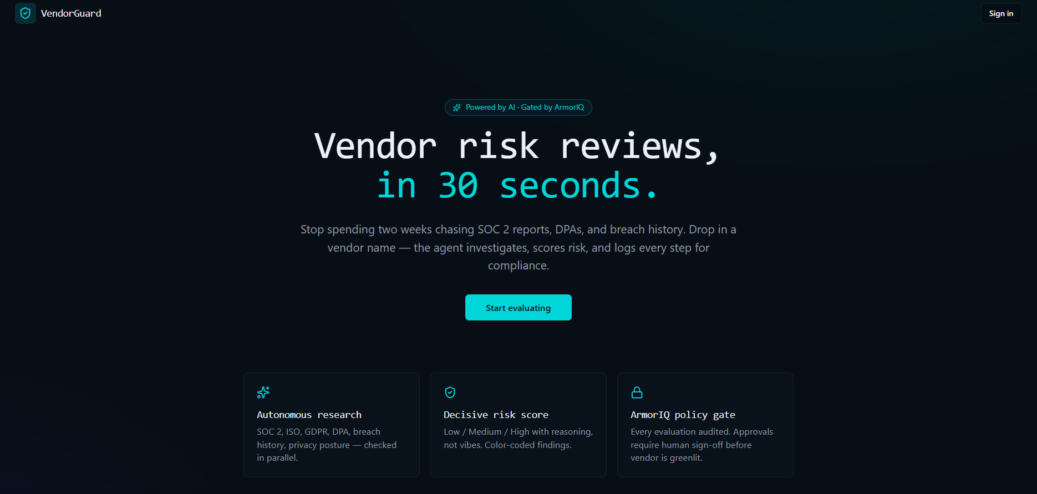
Step 1 → User clicks "Start evaluating" to initiate AI vendor analysis.

Slide 10
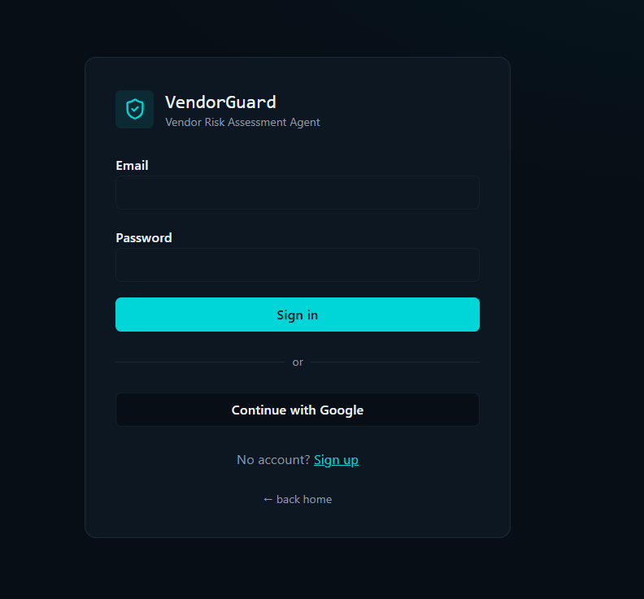
Step 2: Sign in securely using Google Authentication to access VendorGuard.

Slide 11
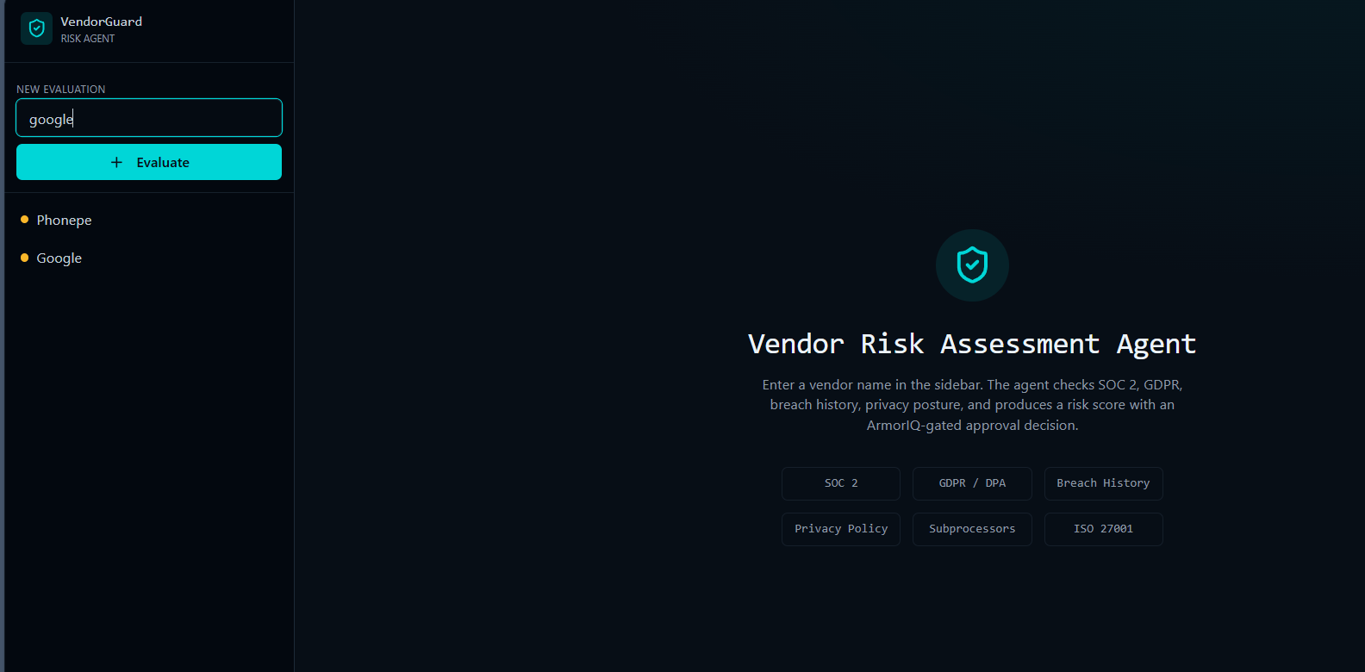
Step 3: Enter the vendor name and click "Evaluate" to start AI risk analysis.
EX : google,random,unbond e.t.c

Slide 12
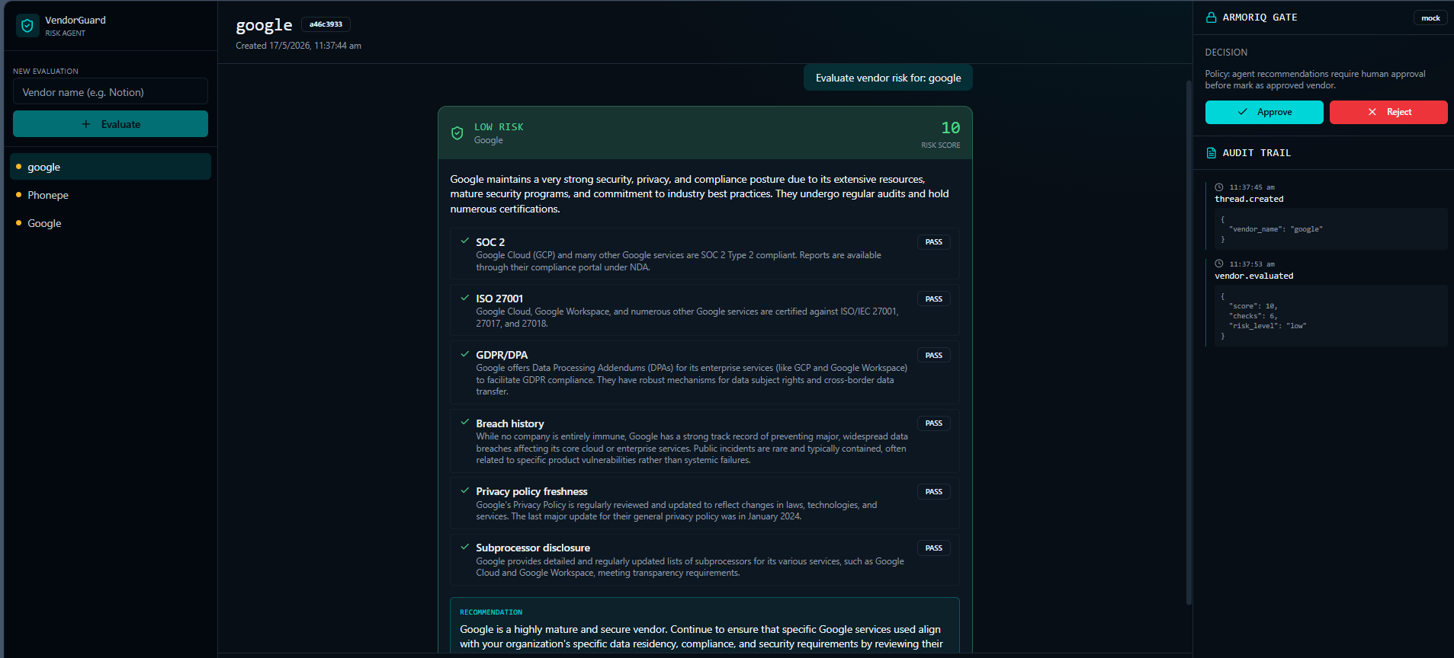
Step 4: The system displays risk level, audit trail, and approval/rejection options for decision-making.

Slide 13
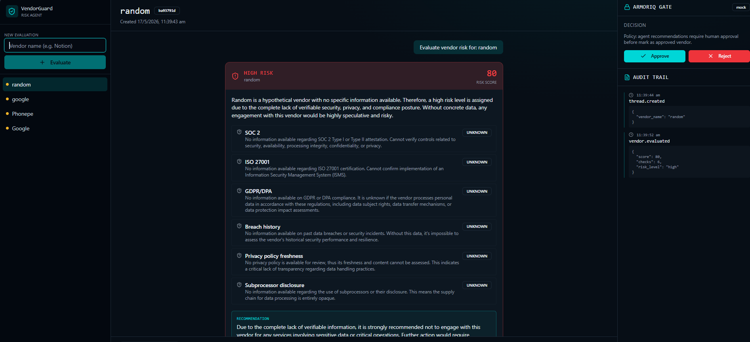
Final AI Assessment & ArmorIQ Validation
✔ AI checks SOC 2, ISO 27001, GDPR/DPA, breach history, and privacy policies. ✔ Generates a risk score and vendor recommendations. ✔ ArmorIQ Gate enables human Approve / Reject decisions. ✔ Audit trail logs every action for compliance and transparency.
Result: Vendor marked High Risk (80) due to missing security evidence.

